Slide 1

Community Exchange
Amaya Bryant & Julianna Truitt
Notes:
In this video we will discuss community exchange, what it is, target customers, risk, opportunites, our plan for the project, and more.

Slide 2
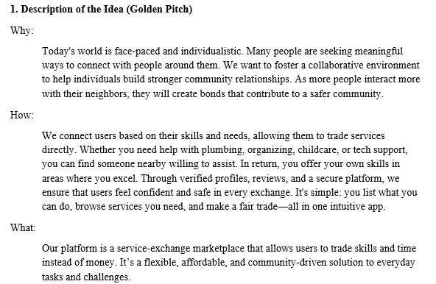

Slide 3
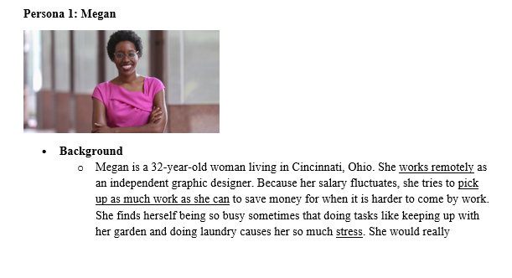
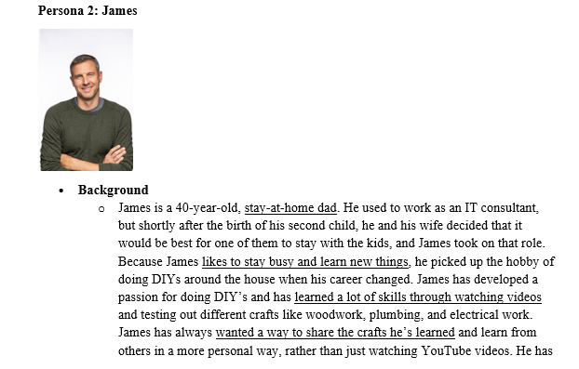
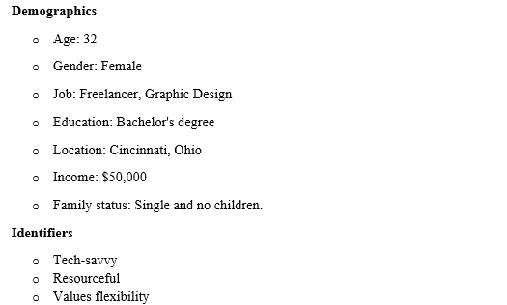
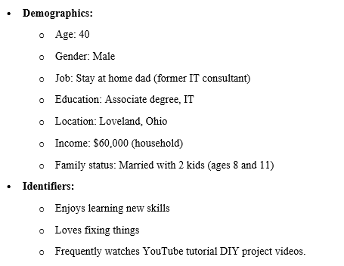
Notes:
Challenges
Her income fluctuates, so paying for services can sometimes feel financially straining.
Struggles to manage her time effectively.
She's cautious about using platforms where she doesn't know the people or feels comfortable trusting strangers with personal tasks.
We can help Provide a platform where Megan can trade her graphic design services for help with tasks like house cleaning, grocery shopping, or pet care.
Elevator Pitch
“Community exchange is a platform where you can share your skills with others. Some people may have a need for graphic design but do not have the resources to pay and would be willing to do something in exchange for you.”

Slide 4
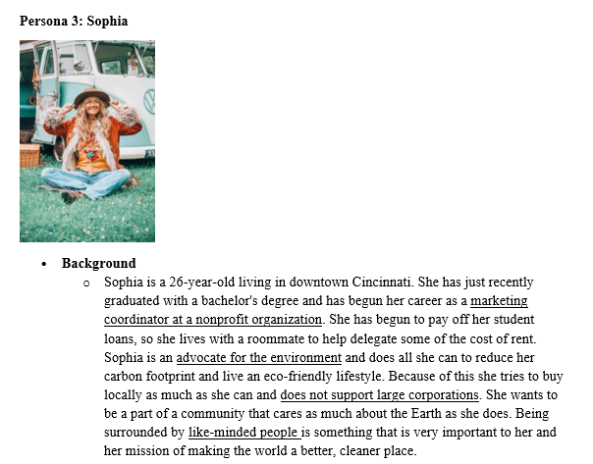
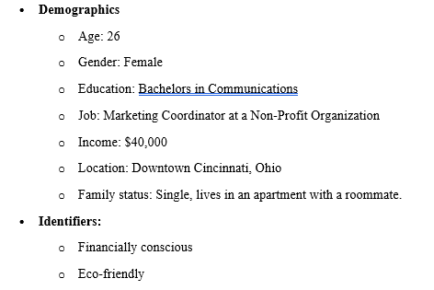

Slide 5
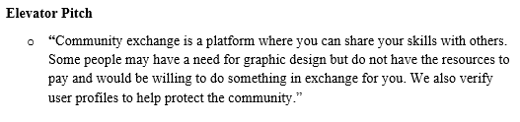
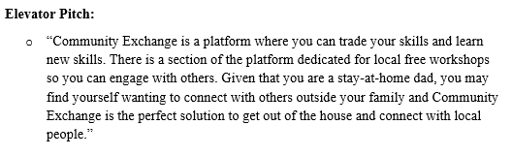
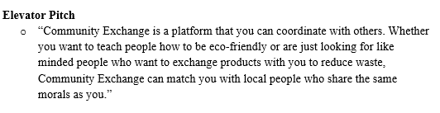
Megan
James
Sophia
Notes:
Megan concerned with strangers and not having someone interested in what she wants to exchange
James concerned that he wont be able to connect with others
Sophia concerned about eco friendly and sustainable living (exchanging goods)

Slide 6
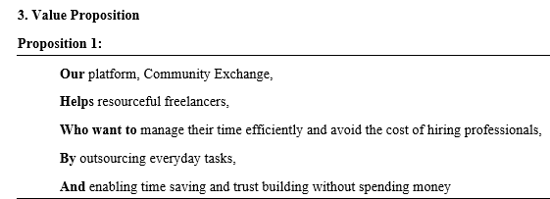
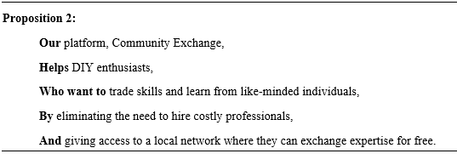
Notes:
Megan concerned with strangers and not having someone interested in what she wants to exchange
James concerned that he wont be able to connect with others
Sophia concerned about eco friendly and sustainable living (exchanging goods)

Slide 7
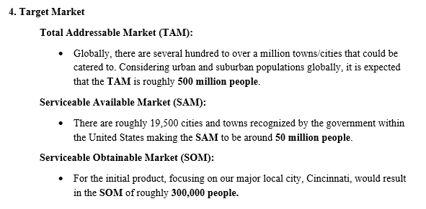

Slide 8
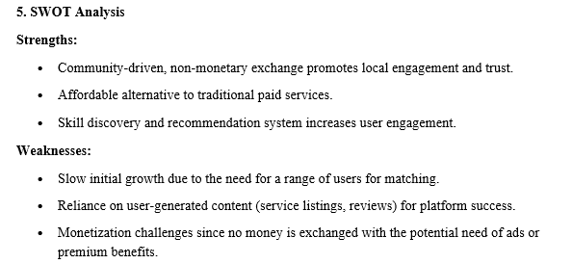

Slide 9
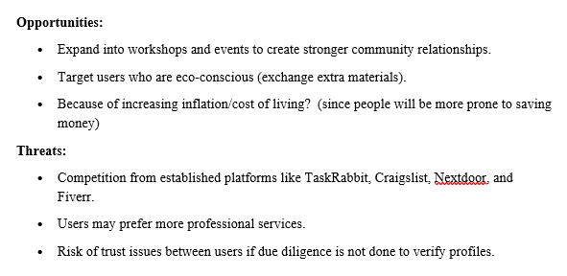

Slide 10
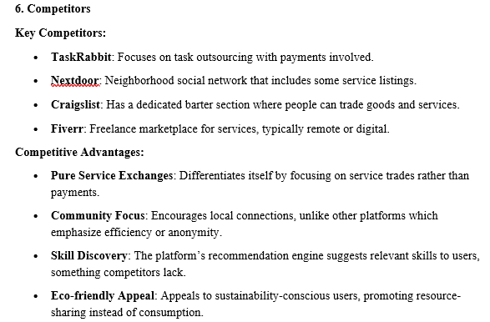

Slide 11
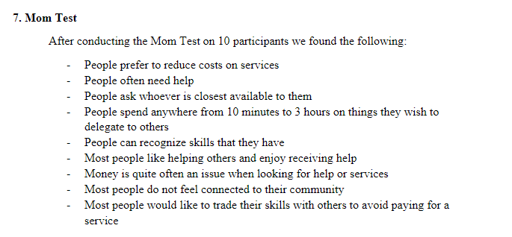

Slide 12
